Slide 1
Tip No. 1:
Put time between your impulse and your action
Emotional Flooding
Flight/Fight/Freeze
Herd Instinct
Takes 20 minutes to calm down
Deep breaths; “relax”
Consult with professional

Slide 2
Tip No. 2:
Avoid catastrophic thinking
“The markets may never recover.”
“I am going to lose all my money.”
“This time it’s different.”
2000? 2008?
“What did you do?”
“How did it work out?”

Slide 3
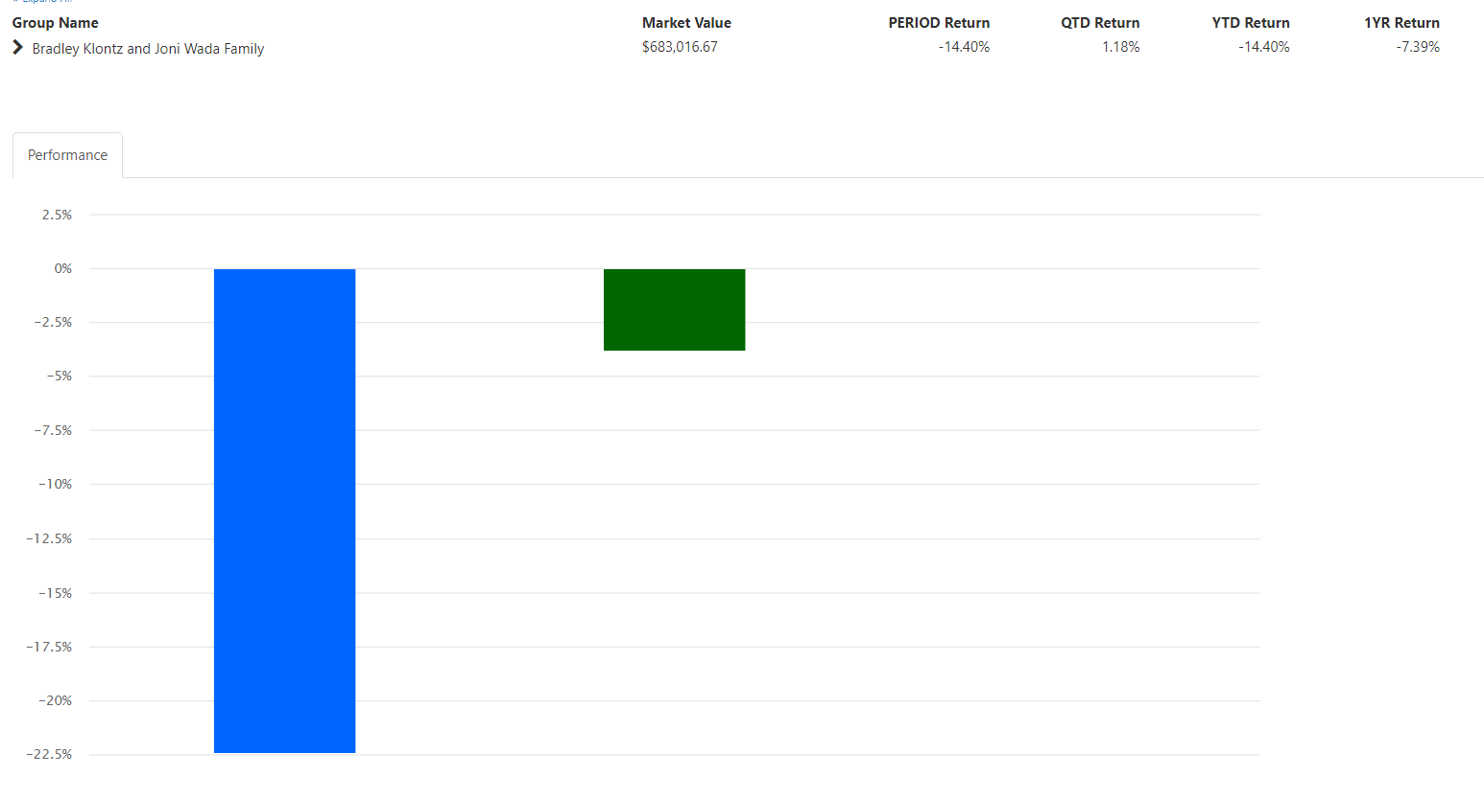
Tip No. 3:
Harness the power of “mental accounting”
Stocks
Bonds

Slide 4
Tip No. 4:
Expand your frame of reference
Frame = your perspective; set of criteria you use to make measurements/judgments
“Are you as short term investor or a long-term investor?”
If long-term, short term fluctuations are irrelevant
Cliff or pothole?

Slide 5
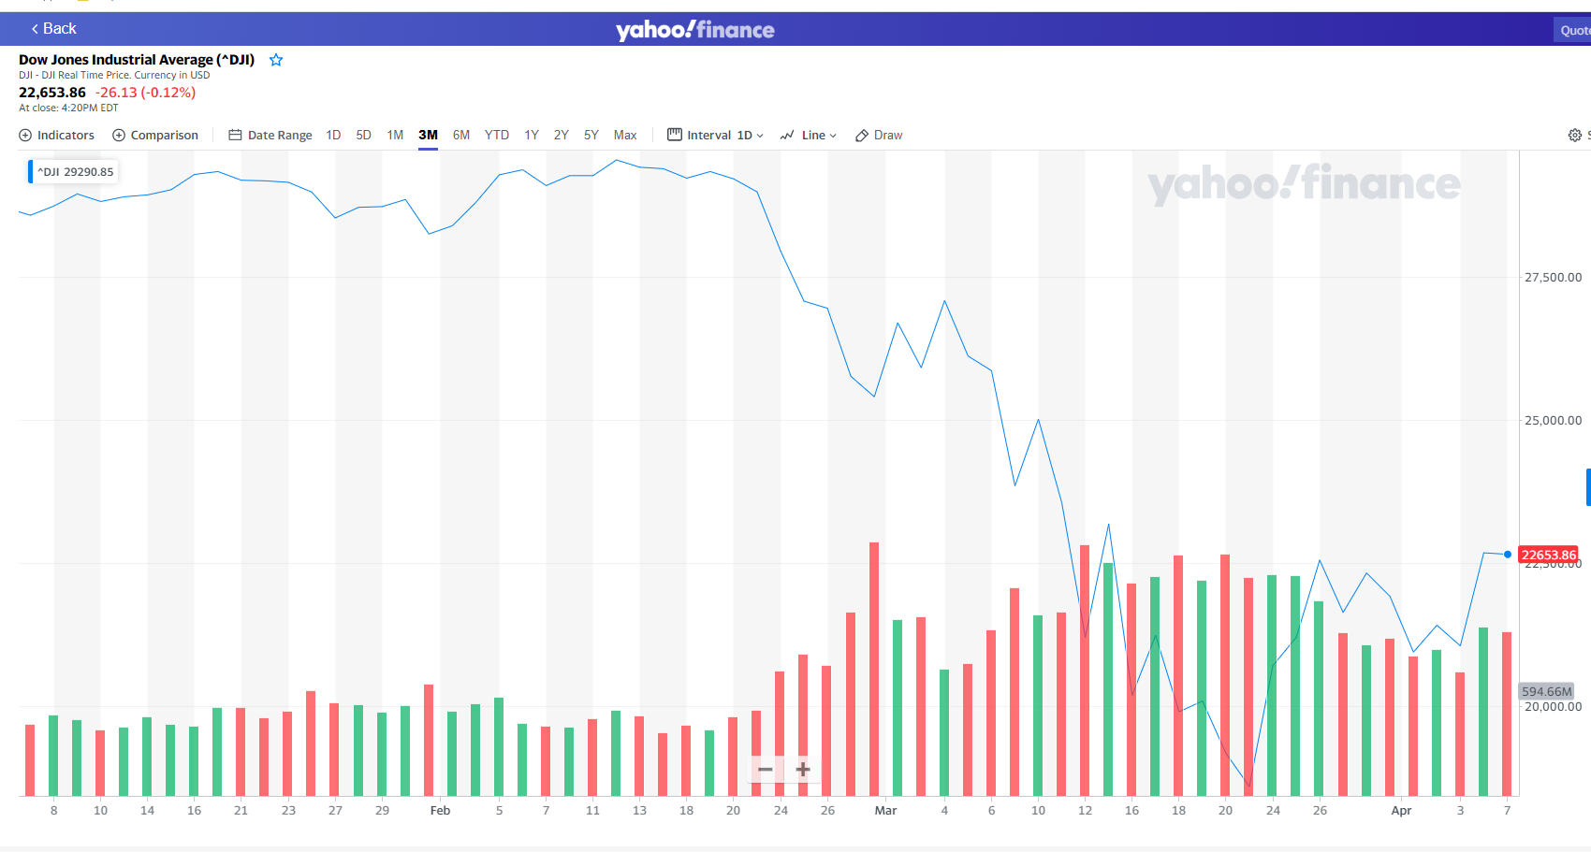

Slide 6
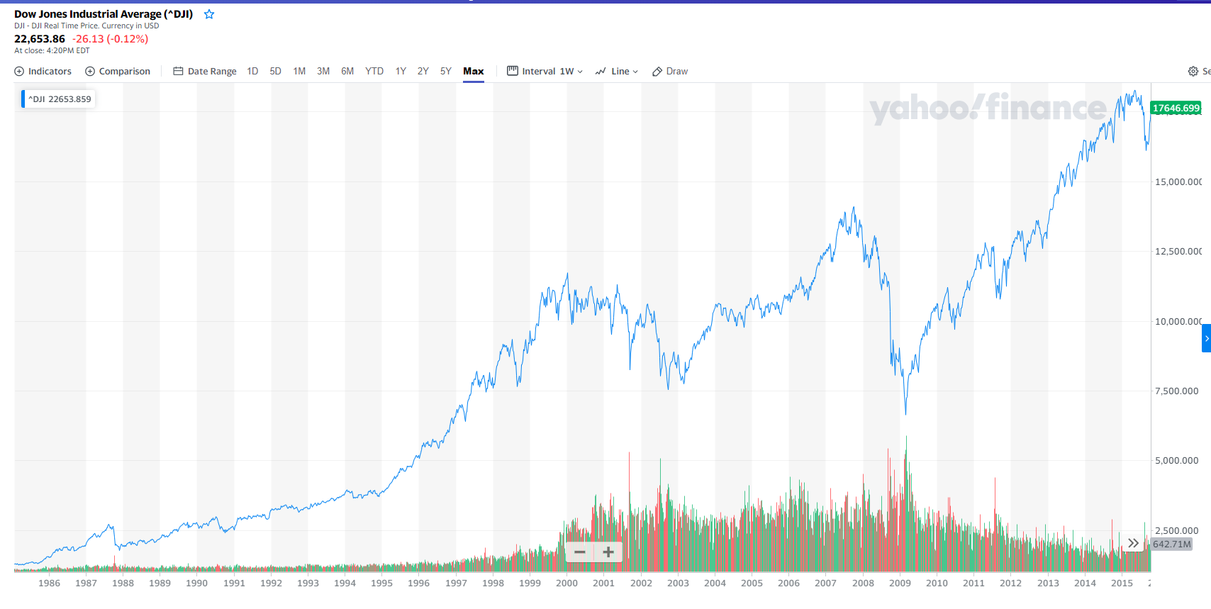

Slide 7
Tip No. 5:
Try the worst-case scenario exercise
Use with caution…
Form of Exposure therapy
Brain on/off switch = life threatening!
$ Situation won’t kill you but your financial stress could kill you.
“Then what would happen…”

Slide 8
Tip No. 6:
Find The
Opportunity
Where is the opportunity?
Self-Development?
Friendships?
Relationship?
Parenting/Grandparenting?

Slide 9
This is going to pass.
Tip No. 7:
Future Self
Exercise
You will get through this.
Picture yourself 5 years from now looking back on this experience.
  How do you wish you would have handled it?
  How do you want people to talk about you?
  “You were a HERO. An inspiration to others. A source of love and support. How DID you do that?”

