Slide 1
THE ROLE OF THE ADVISOR (S)
Who is sitting at the Planning Table
Notes:
Legacy 15 year partner
Build to sell
Confident do itself
Boston Financail – pro baseball player
UMASS – called coach
Putnam Alaksa Airlines
Bobby Orr
Steve and Soup
This is about activity…..until it mainstream
NM commercial

Slide 2
What matters & Why it’s important
How, Who & When to solve it

Slide 3
VISION, VALUES & GOALS
WHAT matters and WHY it’s important.
CONFIDENCE
Results Management Leading to Confidence
4
1
CLARITY
Discovery Leading to Clarity
Sustain
The Results
Identify
Vision & Goals
3
2
Implement
The Solution
Think About
The Solution
RESULTS
Strategy Deployment Leading to Results
DECISIONS
Creative Solutions Leading to Decisions
STRATEGIES, TACTICS & TOOLS

Slide 4
VISION, VALUES & GOALS
WHAT matters and WHY it’s important.
CONFIDENCE
Results Management Leading to Confidence
4
Sustain
The Results
STRATEGIES, TACTICS & TOOLS

Slide 5

Most
Trusted
Advisor
Client
Client
Planning
Legal
THE RIGHT SIDE OF THE TABLETM
Investments
Tax
Insurance
Sales
Person
Sales Person
Sales Person
Sales
Person

Slide 6
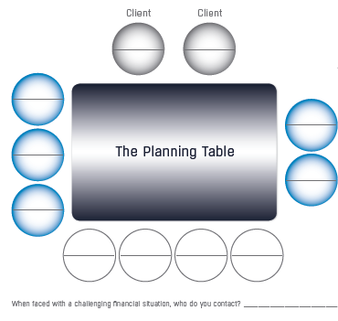
“When faced with a financial challenge, who do you contact?” (possible MTA)
Document Responsibility
Identify the referral source and connect the relationships

Slide 7
VISION, VALUES & GOALS
WHAT matters and WHY it’s important.
CONFIDENCE
Results Management Leading to Confidence
4
What are the results that are providing you confidence?
Sustain
The Results
Who is helping you accomplish your goals?
STRATEGIES, TACTICS & TOOLS

Slide 8
VISION, VALUES & GOALS
WHAT matters and WHY it’s important.
CONFIDENCE
Results Management Leading to Confidence
4
Do have a sense of your Financial Independence?
Sustain
The Results
Who helped you determine that your were? When and do you know your number?
STRATEGIES, TACTICS & TOOLS

Slide 9
Advisor Style | Sales Style | Advice Style | Discernment Style
On Investments | Sells you a great product | Informs about attributes of particular investments | Listens & focuses on desires and needs before recommending
On The Process | TACTICAL - Provides Buy and Sell recommendations | COMPREHENSIVE - Provides planning, investment management services | STRATEGIC - Defines priorities and Executes the best fit solution
On Financial Planning | Has a specific Proposition | Has a Planning Process | Has a System to Create Opportunities
On Focus | Has a Short Term Focus | Has an Annual Focus | Has a Lifetime Focus
On Style | FEAR BASED | OPTIONS BASED | VISION BASED
Insights | Limited insights | Shares personal insights | Helps gain insights
Overall relationship | One Dimensional - Product oriented | Two Dimensional - Service & process oriented | Multidimensional and Intimate
Communication | Inform to Solicit sales | Provide Consultation | Promote Reflection & Results
© 2018 The Legacy Companies, LLC.
Notes:
Flip to page 35

Slide 10
Most
Trusted
Advisor
Client
Client
Planning
Legal
THE RIGHT SIDE OF THE TABLETM
Investments
Tax
Insurance
Sales
Person
Sales Person
Sales Person
Sales
Person

